Slide 1
Clements SNHS VolTrack
Anika Yamdagni

Slide 2

Project Summary
Topic
Web Application Development
Purpose
Track information on volunteer sessions done by the members of Science National Honor Society (SNHS) at Clements HS

Slide 3
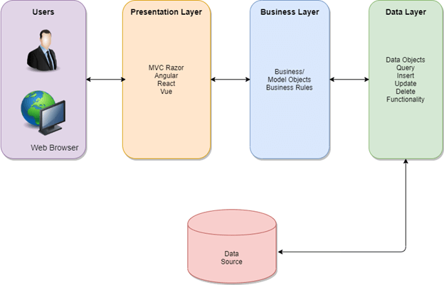
3 Tiers of Web Development

Slide 4
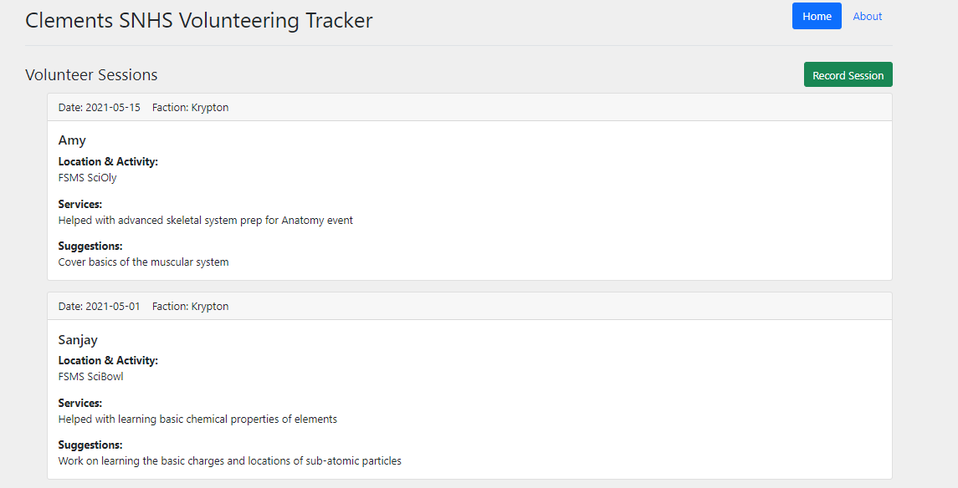
Front-End Application

Slide 5
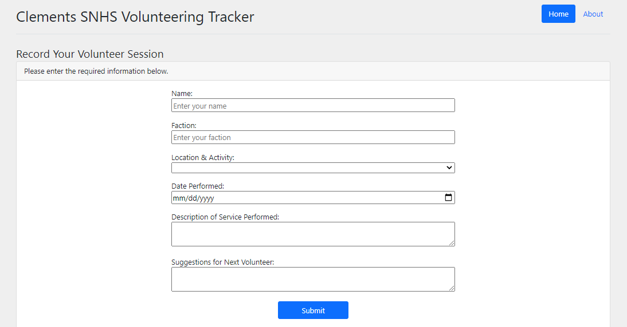

Slide 6
Database Management System (DBMS)
A software package designed to define, manipulate, retrieve and manage data in a database
Researched many different DBMS software: Oracle, MySQL, MSSQL, PostgreSQL, Informix
Decided on MSSQL because it is free, easy to set up a new database, and has user-friendly GUI to create designs, tables, and view data, etc.
Used free version of MSSQL Express 2019 Edition

Slide 7
What I learned and accomplished
Data Types – Different data types available in MSSQL
Entity Relationship - 1 to 1, 1 to Many, Many to Many
Tables - Unit where actual data is stores in rows and columns
PK - The combination of columns which uniquely defines a row
FK - Relationship between data in two tables using PK
Default values – Auto-populate a predefined value on new row insert
Null values – Optional data fields can be set as Nullable
T-SQL - Query language for MSSQL

Slide 8
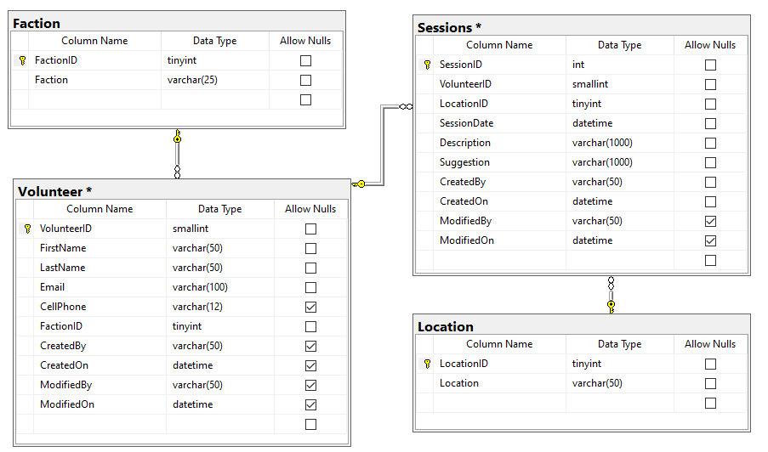
Voltrack Database

Slide 9
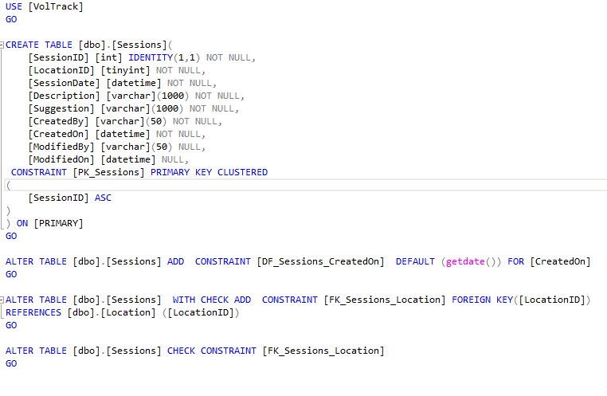
T-SQL Code to Create A Table

Slide 10
Next Steps:
Connect front-end and back-end!
Retrieve data from tables to display in the front-end via RESTful GET APIs
Save the data entered by the user in the front-end via RESTful POST APIs
Host application!
Create account and host using myASP.NET

Slide 11
Works Cited
https://www.ibm.com/cloud/learn/three-tier-architecture
https://www.techopedia.com/definition/24361/database-management-systems-dbms
https://improvado.io/blog/top-25-best-database-management-software
https://docs.microsoft.com/en-us/sql/ssms/sql-server-management-studio-ssms?view=sql-server-ver15
https://www.tutorialspoint.com/t_sql/t_sql_data_types.htm
https://www.redhat.com/en/topics/api/what-is-a-rest-api

